Slide 1


תכנות מונחה עצמים
מייל הקורס
oopariel2025@gmail.com

Slide 2
נושאים להיום
הסבר על הקורס
הקדמה
עקרונות
OOP vs FP

Slide 3
כמה מילים על הקורס
חשיבות הקורס
הקורס מורכב מתאוריה של התכנות, והתרגולים יהיו שילוב של מצגות לדוגמאות קוד
לתכנת זה לא רק לכתוב קוד – צריך גם לדעת איך לכתוב אותו
קורס מאוד משמעותי לתעשייה ולראיונות עבודה
עבודה עצמית – מדובר בנושאים גדולים שהקורס לא מעמיק בהם עד הסוף
מנהלתיות
יש 3 מטלות בקורס
כל הקודים והמצגות נמצאים בגיטהאב הקורס
יצירת קשר
מייל הקורס: oopariel2025@gmail.com
כל פנייה בכל נושא תיעשה דרך מייל הקורס
פנייה כללית על המטלות אך ורק בפורום הקורס

Slide 4
תכנות מונחה עצמים, הוא פרדיגמת תכנות המשתמשת ב"עצמים" (אובייקטים) לשם תכנות תוכניות מחשב.
פָּרָדִיגְמָה היא תבנית מחשבה המגדירה את העמדה של אדם, ומשפיעה על תפיסת המציאות שלו ועל הדרך שבה הוא רואה את העולם. בהקשר המדעי, פרדיגמה מתייחסת לאוסף ההנחות ומושגי היסוד המגדירים את עמדתה של קהילה מדעית מסוימת ביחס למושא המחקר. ויקיפדיה

Slide 5
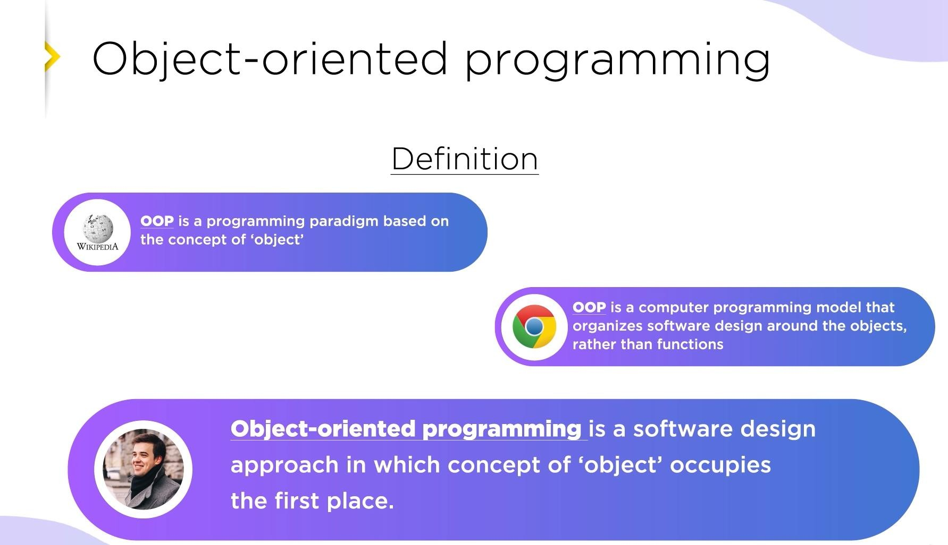

Slide 6
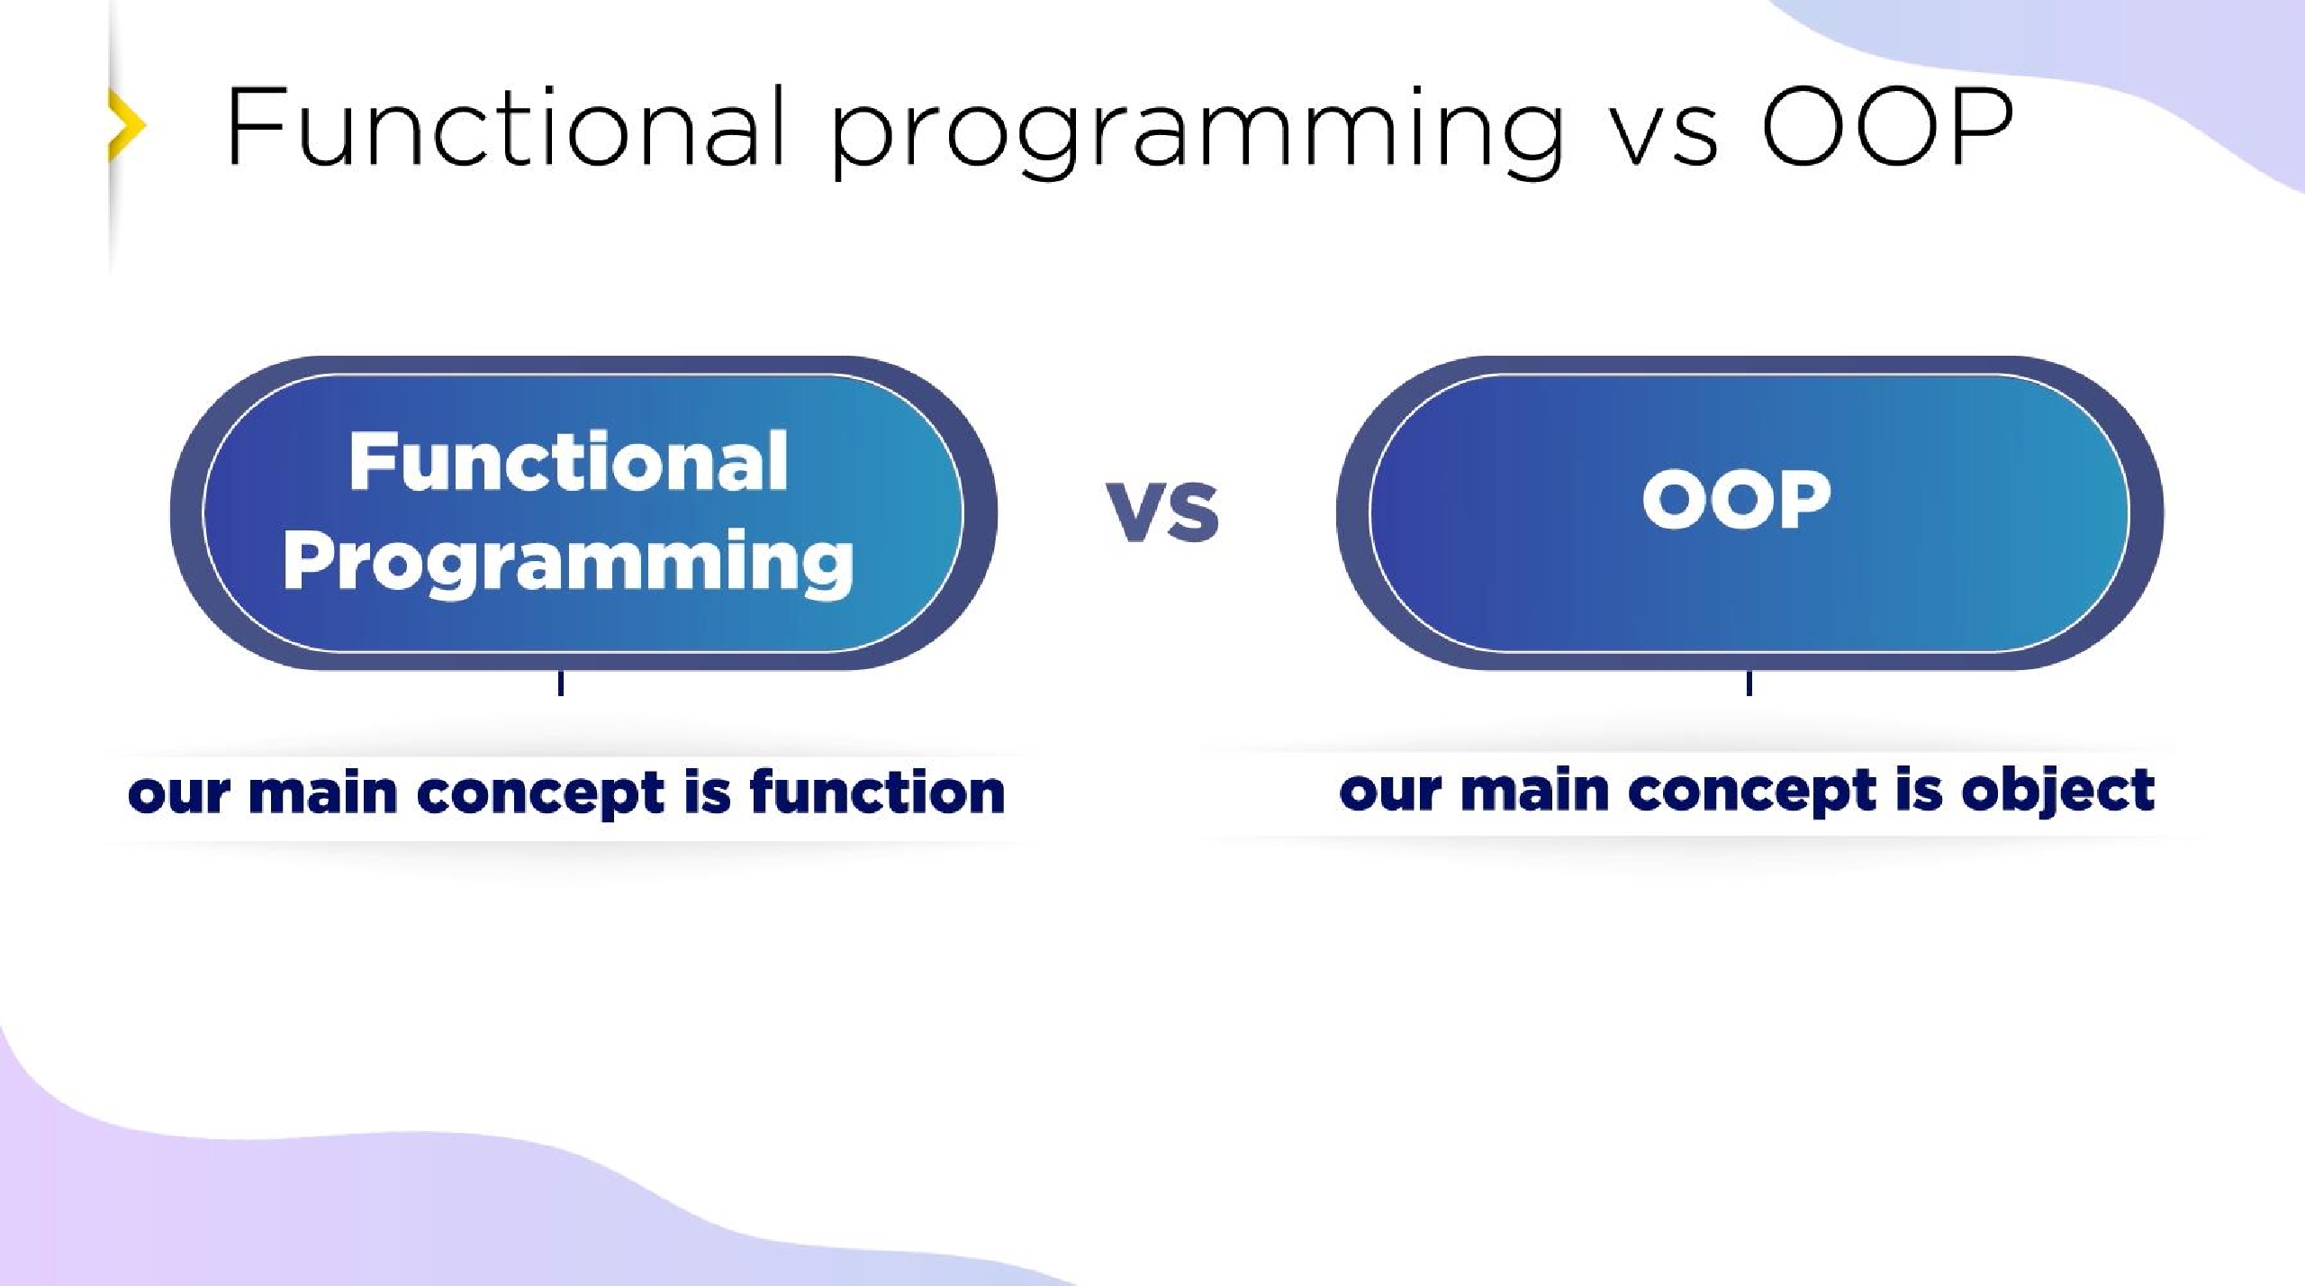

Slide 7
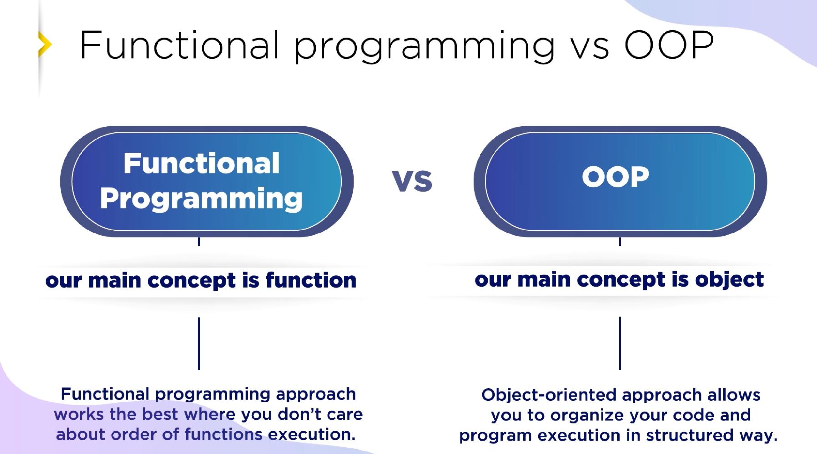

Slide 8
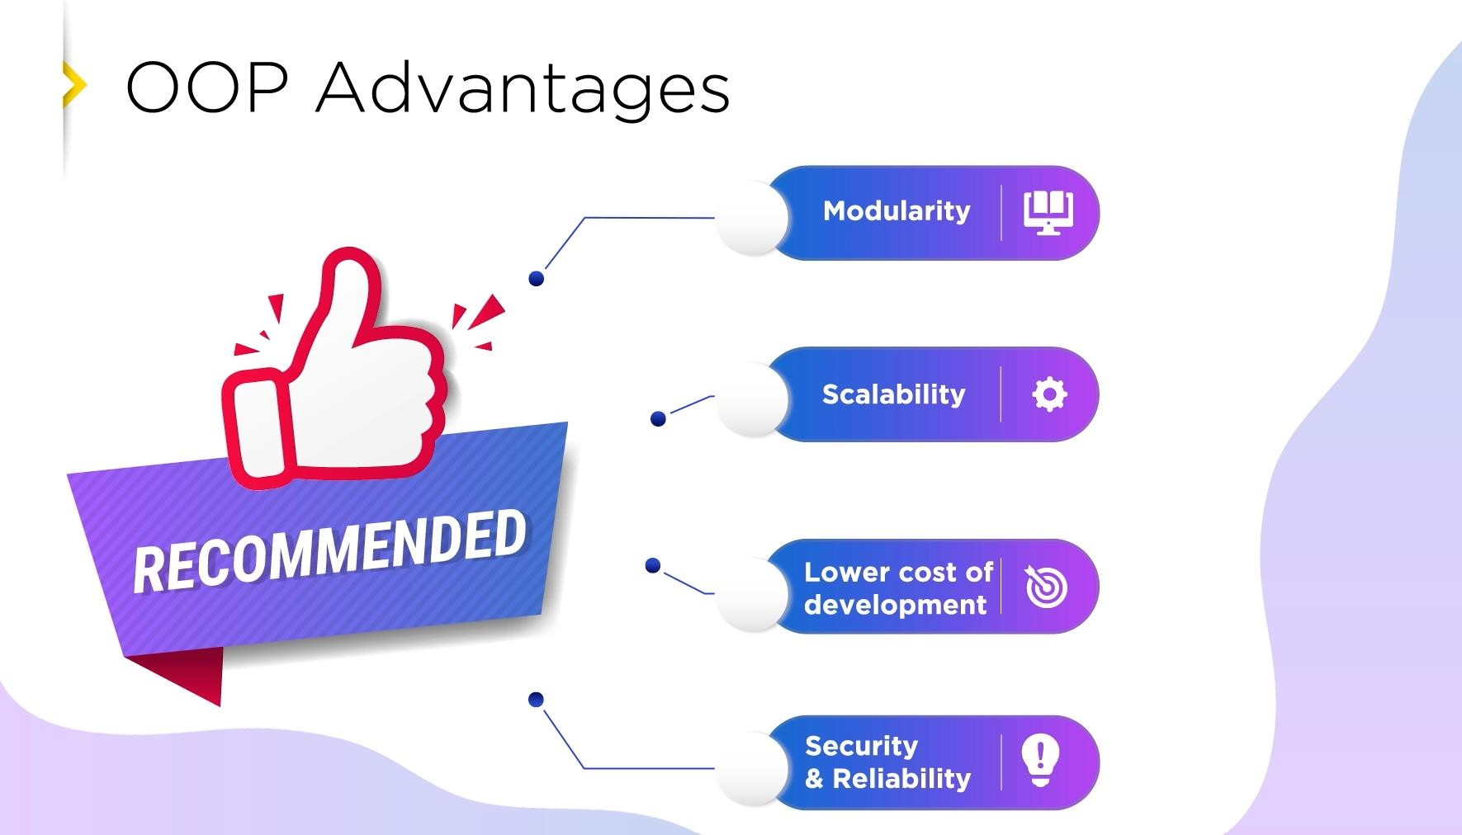

Slide 9


Slide 10
Modular Design
Explanation: OOP organizes code into separate, self-contained modules (classes), each handling a specific responsibility.
Example in OOP: In a shopping cart system, you could have: User, Product, and Order classes, each handling its data and logic.
Benefit: Each class can be developed, tested, and debugged independently, making it easier to maintain.
Each class can be easily replaced.
Comparison with FP: While FP can achieve modularity by isolating functions, dependencies often emerge between functions, making it harder to group related data and behaviors together. In OOP, all relevant data and methods are encapsulated in one module.

Slide 11


Slide 12
Reusability
Explanation: OOP allows reusability through inheritance and polymorphism, making it possible to build on existing code.
Example in OOP: If you create a Vehicle class, you can reuse it to create
Car, Bike, and Truck subclasses share common properties but also have unique features.
Benefit: Less duplicate code is needed; new features or types can be added without rewriting existing code, which can cause many stupid problems.
Comparison with FP: FP promotes reusability through pure functions and composition, but adding new functionality might involve re-creating or modifying existing functions, which can lead to redundancy. OOP inherently supports the reuse and extension of existing classes without changing them.

Slide 13


Slide 14
Scalability
Explanation: OOP makes scaling easier by allowing the system to be expanded by adding new classes or subclasses.
Example in OOP: In a bank system, adding new account types (e.g., SavingsAccount, CheckingAccount) can be done without changing the base Account class.
Benefit: OOP structures allow you to introduce new functionalities smoothly, fitting them into the existing hierarchy.
Comparison with FP: FP can become challenging in large systems, where functions must interoperate in complex ways. OOP’s structure allows large systems to be scaled in a way that maintains order and clarity.

Slide 15
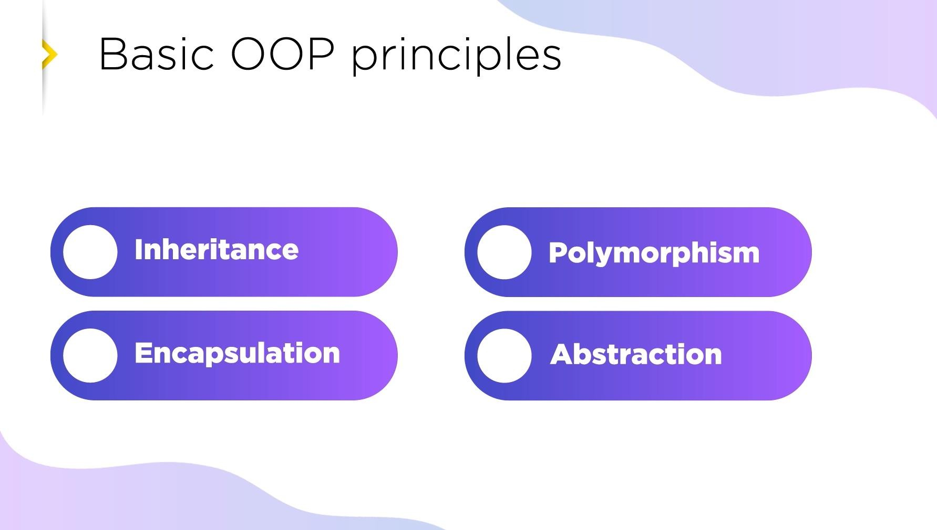

Slide 16
Inheritance
Definition: Inheritance allows a new class to adopt properties and methods from an existing class, reducing redundancy.
Analogy: A base “Animal” class can be extended by “Dog” and “Cat” classes, each inheriting core animal traits but with unique behaviors.
class Animal {
public void eat() {
System.out.println("This animal eats.");
}
}
public class Dog extends Animal {
public void bark() {
System.out.println("The dog barks.");
}
}
public class Cat extends Animal {
public void meow() {
System.out.println("The cat meows.");
}
}
Key Points:
Dog and Cat inherit the eat method from Animal.
Reduces code redundancy by centralizing common traits in Animal.

Slide 18
Polymorphism
Definition: Polymorphism allows different objects to respond uniquely to the same function call, making code flexible and extensible.
Analogy: Different appliances can respond to a "turnOn" command in their own way – a fan starts spinning, while a light turns on.
class Animal {
public void makeSound() {
System.out.println("Animal makes a sound");
}
}
class Dog extends Animal {
@Override
public void makeSound() {
System.out.println("Dog barks");
}
}
class Cat extends Animal {
@Override
public void makeSound() {
System.out.println("Cat meows");
}
}
Key Points:
makeSound() produces different outcomes depending on the object type (Dog or Cat).
Enables a flexible design where specific behavior depends on the object’s class.

Slide 20
Encapsulation
Definition: Encapsulation restricts access to an object's internal state and allows interaction only through methods. This keeps data safe from unintended changes.
Analogy: Think of a remote control – it only exposes certain buttons to operate the TV, hiding the complex electronics inside.
public class TV {
private boolean isOn = false;
public void turnOn() {
isOn = true;
}
public void turnOff() {
isOn = false;
}
public boolean isTVOn() {
return isOn;
}
}
Key Points:
Only public methods (turnOn, turnOff) allow changes to isOn.
Internal state (isOn) is private and not accessible directly.

Slide 22
Abstraction
Definition: Abstraction hides complex implementation details and shows only the essentials, allowing the user to interact with simplified interfaces.
Analogy: A car dashboard only shows essential controls like speed and fuel level, hiding engine complexity.
abstract class Car {
public abstract void start();
public abstract void stop();
}
public class ElectricCar extends Car {
@Override
public void start() {
System.out.println("Electric car is starting...");
}
@Override
public void stop() {
System.out.println("Electric car is stopping...");
}
}
Key Points:
Abstract methods (start, stop) provide an interface for derived classes.
The internal mechanism of ElectricCar start/stop is hidden.

Slide 24
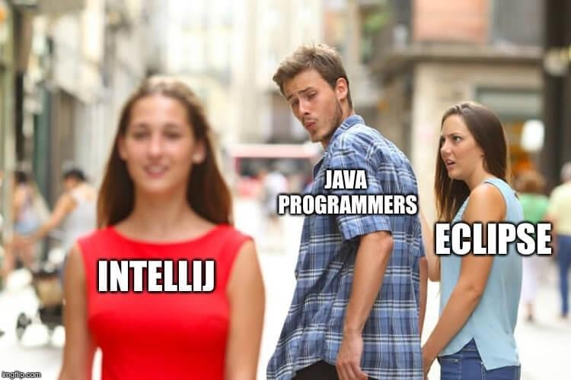
INTELLI vs ECLIPSE

